Slide 1
Technology and 21st century education
Adrian Blight
CEO, Imagine Education, UK

Slide 2
Introduction to Imagine Education
Global network of education and technology specialists
Strategic consultancy, product development and training
Work with governments, organizations (UNESCO, The British Council) and companies (Microsoft, Cisco, Promethean)
Learning first, technology second

Slide 3
Overview
What is 21st century teaching and why is technology (ICT) important?
How can we build educator capacity?

Slide 4
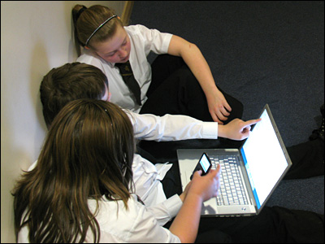
Good use of technology?
A- YES
B – NO
C - MAYBE

Slide 5
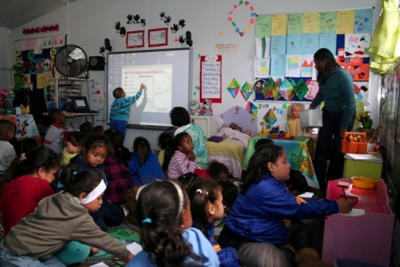
Good use of technology?
A- YES
B – NO
C - MAYBE

Slide 6
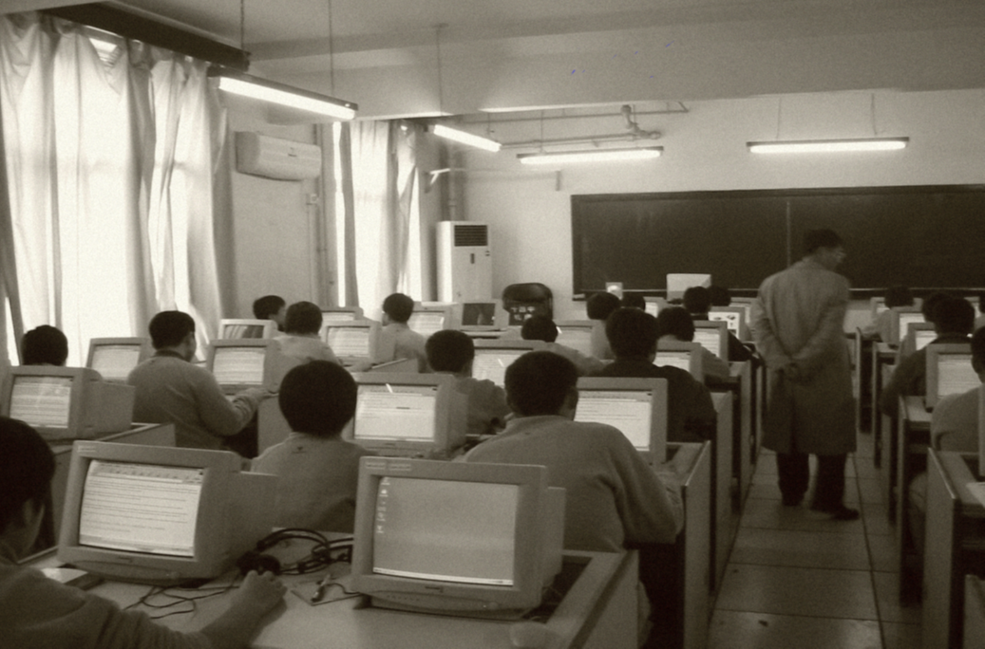
Good use of technology?
A- YES
B – NO
C - MAYBE

Slide 7
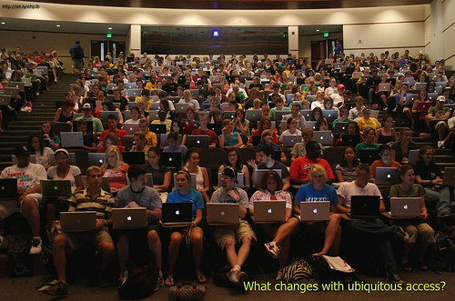
Good use of technology?

Slide 8

Tell the story in 6 words
Notes:
This image is presented to participants who will turn to the person next to them. Give them 2 minutes to come up with a story about the picture in 6 words!
On the next slide, you could ask them to see how many skills they used from the list
Its all about creativity + collaboration + simple technology to free up teacher to get involved in discussion

Slide 9
College and Career Readiness
Think creatively | Interact effectively with others
Reason effectively | Produce results
Make decisions | Adapt to change
Solve problems | Manage goals and time
Communicate clearly | Use and manage information
Collaborate with others | Be flexible
Analyse media | Work creatively with others
Notes:
Put this slide and ask a few groups how many skills did they use in the activity.
This is designed to show that collaboration starts with providing a suitable context to get conversations started.

Slide 10
What is 21st century teaching and why is technology/ e-learning important?

Slide 11
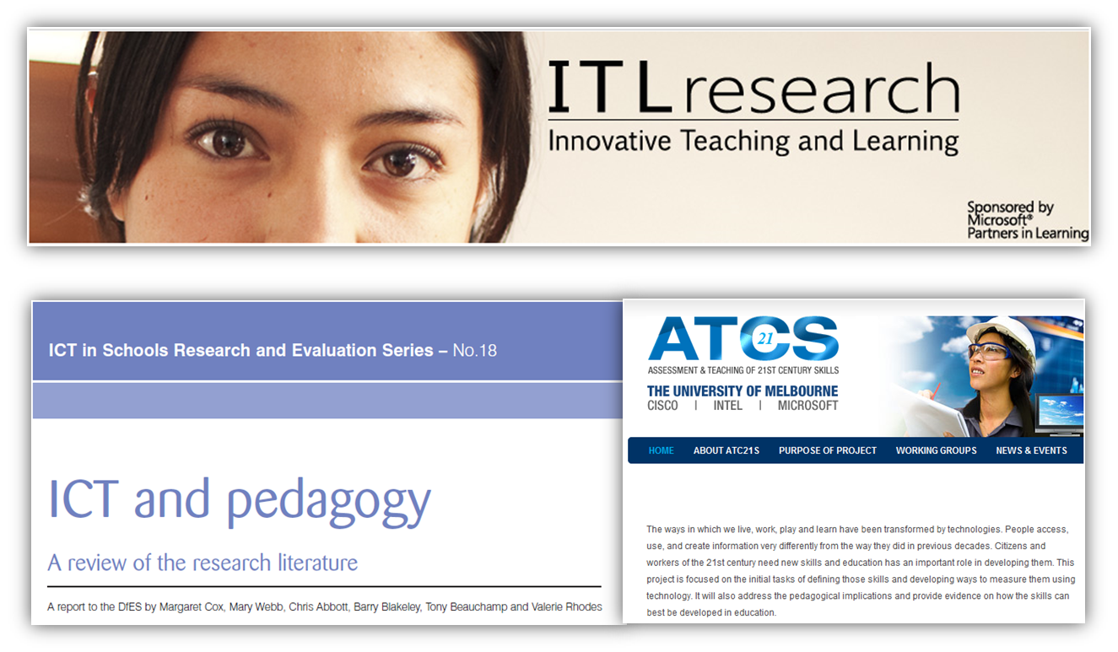
Technology in Education: The global report so far...
Notes:
There are many research initiatives which are looking at what the impact of ICT has been so far. The three shown are worth looking at as each tries to chart a way forward and enhance the impact of ICT in education.
The idea behind leapfrogging is about learning from others experience and not making the same mistakes. So far, systems have “replicated” mistakes and the results are as expected!
http://www.atc21s.org/home/
http://partners.becta.org.uk/upload-dir/downloads/page_documents/research/ict_pedagogy_summary.pdf
http://www.itlresearch.com/

Slide 12
Technology in Education: The global report so far...
“Some pockets of innovation in some schools in some countries…”
“Some transformed practice in some schools in some countries…”
“Some ROI on heavy investment in some countries...”
“Most commonly used to reinforce existing pedagogies…”
In summary:
“Lots of room for improvement. Nobody has fully succeeded so far.”
Notes:
Lets look at where we are globally with ICT in education....
Too often ICT in education is like somebody trying to teach you how to ride a bicycle by teaching each element separately e.g. How to balance, how to pedal, how to steer. This is a recipe for failure as it is important to see whole picture. What has happened is “tinkering” with parts of the system rather than looking at fixing the whole.
We live in a time of constant technological change and innovation, which affects nearly every aspect of our lives—from the way we communicate to how we do our jobs and spend our leisure time. Yet in the world of education, comparatively little has changed. Classrooms across the world look much as they always have, with a single teacher up front imparting knowledge to students seated at rows of desks. The school day is divided into periods that correspond to specific subjects in a fixed curriculum. Within this traditional model, some schools might add in a bit of technology as a way to increase efficiency or access to information.

Slide 13
Research review: Technology in education
Teacher training should not just encompass technology skills but rather a full understanding and complete mastery of ICTs as pedagogical tools (Punie et al, 2008).
The developments in ICT provide very different learning opportunities, and a need to design a new ‘integrated pedagogy’ has been identified (Cornu, 1995).
A compelling rationale for using ICT in education is its potential to act as a catalyst in transforming the teaching and learning process (Hawkridge, 1990).

Slide 14
Technology outside education today
1.5 million pieces of content are shared on social media…daily
120,000 blogs created daily
2 blogs created per second
Generation Y and Z consider e-mail passé…In 2009 Boston College stopped distributing e-mail addresses to incoming freshmen
by 15 year olds
Notes:
We are going through a technological revolution. We live in “exponential times”. Here are some of the impact of social media on consumers becoming producers.
http://www.youtube.com/watch?v=sIFYPQjYhv8&feature=player_embedded#!

Slide 15

Digital Natives
Notes:
This short video clip which will be used to warm things up!

Slide 16
Digital Natives
The Emerging New Student
The Emerging New Learning Preferences
Digitally Literate
Always Connected
Experiential
Mobile
Community-Oriented
Learner-Centered
Interactive
Experiential
Adaptive

Slide 17
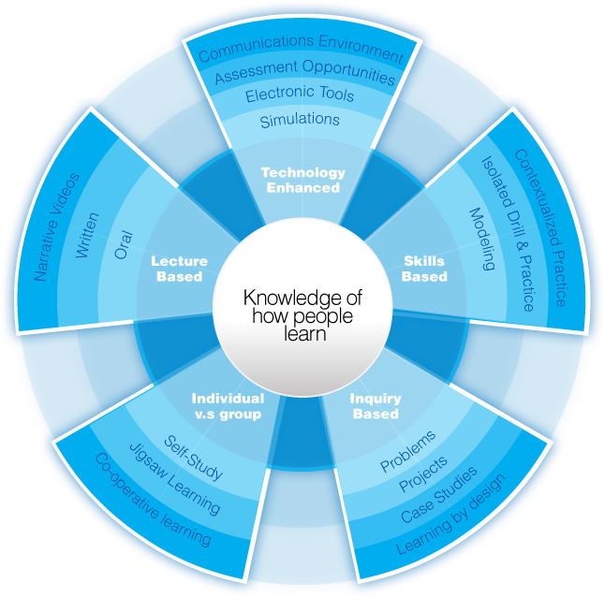
A 21st century curriculum?
Multi-Literacy
Critical Thinking
Problem Solving
Information Gathering
Information Analysis
Information Ethics
Project-Based Learning
Problem-Based Learning
Inquiry-Based Learning
Discovery

Slide 18
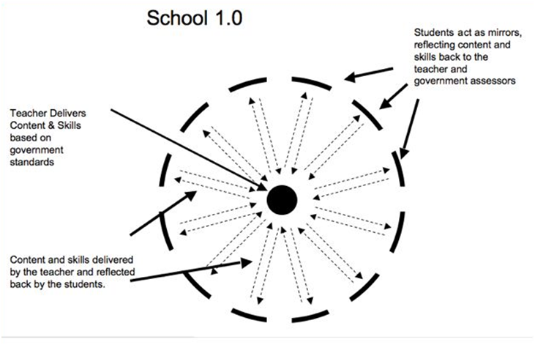
David Warlick
Notes:
This is the traditional model of teaching and learning around the world. This is due to use high stakes summative assessment. This is sometimes known as the compliance model of teaching and learning. Every student has an audience of 1, their teacher.
This model is about what students learn and not how they learn or why they learn.
Caution: This model is sometimes a viable option when dealing with large class sizes or for some learning objectives. However, even in this large class sizes, simple technology can transform learning. For example, a projector and laptop loaded with a multimedia resource can totally transform such a classroom.

Slide 19
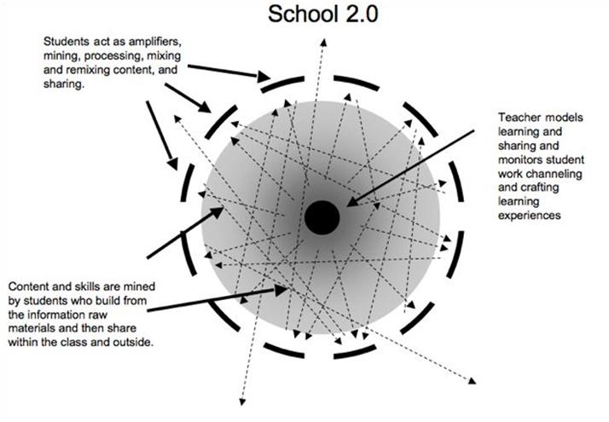
David Warlick
Notes:
This is collaborative model of teaching and learning. This model can be driven by project based learning. However, to be fully embedded and practice scaled up, it requires curriculum and assessment reform as well so that what is achieved in the collaborative learning process can be adequately rewarded and benchmarked.
Also students need a wider audience and this is why social networking is popular.

Slide 20

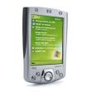

Technology and the teaching and learning process
Input process output
21st century skills: creativity, group work, time management
communications skills, reflection
Notes:
The traditional way of teaching has a lot a input from the teacher at the start of the lesson, very little processing and a high amount of output e.g. lots of graphs produced.
What happens in a lesson with ICT is that here a lot of processing. This enhances the process of learning.

Slide 21
Curriculum Architecture
TUTORS
MENTORS
ASSESSORS
My subject group
My tutor group
My project group
Continuous availability of relevant
collaborative experiences
Investigation
task
Reinforcement
Video on demand
Using
Multimedia
Practice
materials
Using
Multimedia
Practice
materials
Discussion
Sychronous
VC with
expert
Research
Asynchro
Assessment
Virtual
*Formative
Sumative
*Physical
Using
Multimedia
Physical
Class
VC with
expert
Physical
Class
Personalised & Collaborative Learning
Changing Space, Time and Resource
Notes:
So what does a learning journey look like?
How are the different technologies and experiences blended together.
This slide shows just one example of how one module of a learning journey might be put together.
The red arrow represents a time line and all blocks above the line are either entirely or partially virtual.
This journey starts with a meeting in a physical space where the physical tutor introduces an expert over TP.
The expert introduces the learners to some multimedia content which is available after the physical class ends.
The tutor informed the class via the collaboration space (represented by the blue cloud) of practice materials and reinforcement video clips that can be access on demand to support learners when they need support.
The tutor, at the beginning also enabled the learners to form into groups who where given a research task to collaborate on after they had done some initial thinking which they used the multimedia content for again.
The groups were also given a problem solving task that required the research materials to complete.
All of the groups shared their research and problem solutions on a secon TP which allowed them to then practice their new skills.
A synchronous voice and text discussion allowed all of the learners to fully understand the learning objectives before an assessment, using the multimedia as a reference was organised to summarise the learning.
Throughout all of the activities the physical tutor was available for support as was a mentor for each learner and assessors look at activity, learner by learner to a) form an opinion of progress and b) feedback to all concerned so that the learning journey could be modified to reinforce and accelerate learning.
The same system enables all learners to form subject learning groups, on line as well as enabling social and support groups of different peers as necessary.
The shift from Physical to virtual provides more opportunities and enables better learning experiences than can be achieved within the fixed walls of any classroom

Slide 22
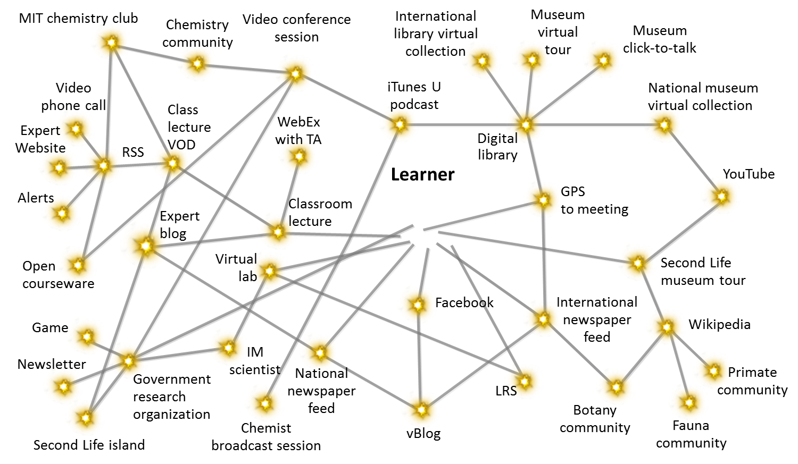

The Hyper-Connected Learner

Slide 23
What does this model require?
Typified by
Outcomes
Content
New Learning Modalities
Appropriate Media Mix
Personalisation
21st Century Skills embedded
Assessment
On-line
Remote
Consistent impartial results
International standards
From personalisation to community Knowledge ‘Acquisition’
Learning Communities
Better Learning outcomes
Pedagogy
Platform
Applications
Services
Accurate Matching
Participation & Collaboration
Community Building
Technology
Professional Development
eLearning & Distance Learning
Coaching & Mentoring
Ongoing Collaborative Learning in Knowledge Communities

Slide 24
How can we build the required educator capacity?

Slide 25
Critical Questions
Are our education institutions ready for this generation and the next?
How do we create the learning environments that engage this generation to help them reach their full potential?
How do we equip these students with the skills and knowledge they need to be competitive in a global, information-based economy and contributing citizens?
How do we equip educators with the skills required to achieve these goals?

Slide 26
Educators’ typical reactions to ICT
Does the change (potentially) address a need?
Will students be interested?
Will students learn?
Is there evidence that the change works?
Is it clear what I will have to do?
Will the change take up more time?
Will I need to develop new skills?
Will the change interfere with existing priorities?
How rewarding will the new experience be?

Slide 27
UNESCO Competency Framework Objectives
To constitute a common global core curriculum
To provide a basic set of qualifications
To extend educators’ professional development so as to advance their skills in pedagogy, collaboration, and school innovation using ICT.
To harmonise different views and vocabulary regarding the uses of ICT in educator professional development.

Slide 28
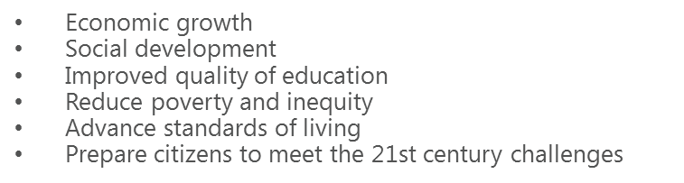

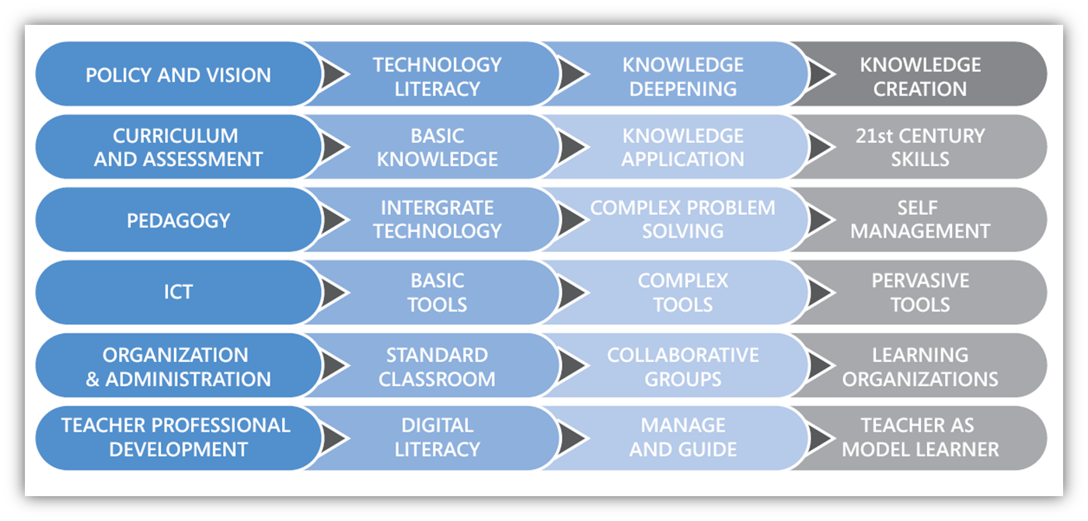
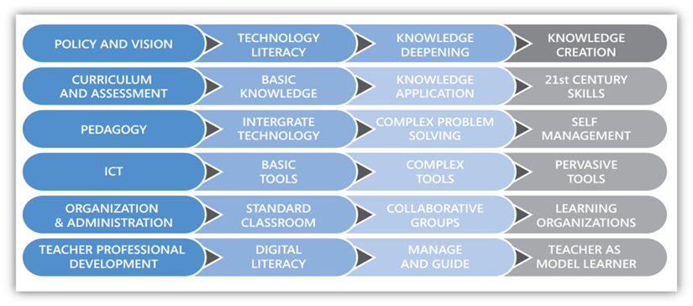

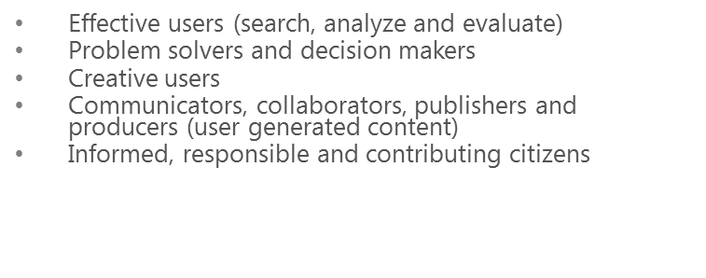
How can technology help our teachers address these demands?

Slide 29
Technology and motivation
“My goal in life is to find ways in which children can use technology as a constructive medium to do things that they could not do before; to do things at a level of complexity that was not previously accessible”
Prof. Seymour Papert 1998
Notes:
This is critical when designing projects in the classroom. Too often we see technology being used to replace “good” traditional practice. What we should be doing to see how we could transform current practice using some of these tools.

Slide 30
Time for questions
adrian@imagineeducation.net
www.imagineeducation.net

