Slide 1
Innovation in Education
Kranjska Gora , 23rd March 2012
Danny Arati
Education Manager Europe, Intel

Slide 2
Introductions
Work Late
X
Late, Quiet
Late, Noisy
Early, Quiet
Early, Noisy
A
B
Absolute Silence
Background Noise
C
D
Work Early
Notes:
Additional levels of complexity can be added: e.g. workplace, inside vs outside?; or food/drinks with work? Etc.

Slide 3

Reality in schools
Notes:
Cohorts by age; timetable is uniformed; tendency to have strict seating arrangements, etc.

Slide 4
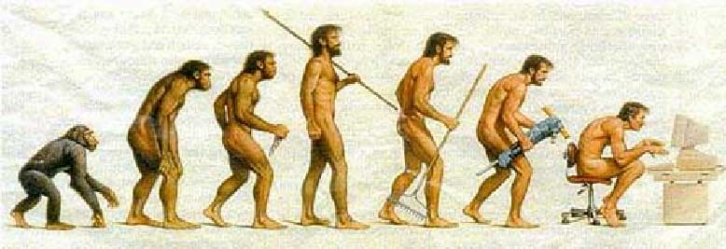
Innovation vs Evolution
(or: The importance of the usage model)
Notes:
Evolution = Change over time
PDF example

Slide 5
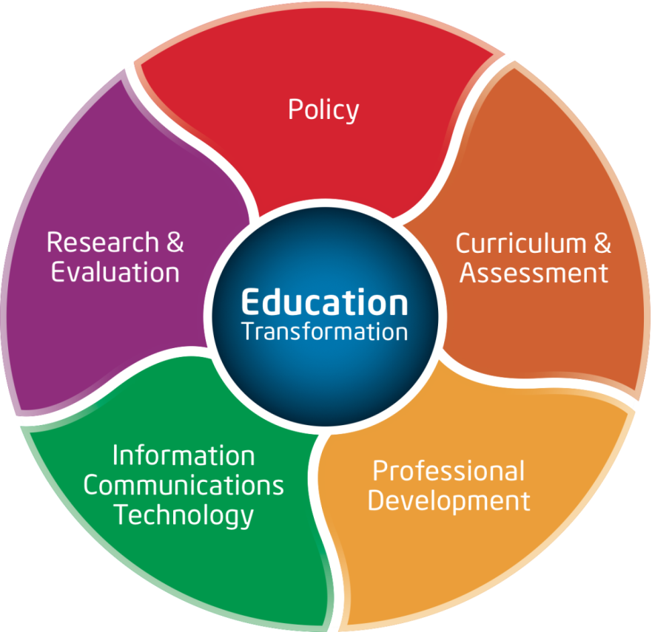
Intel’s Model for Education Transformation

Slide 6
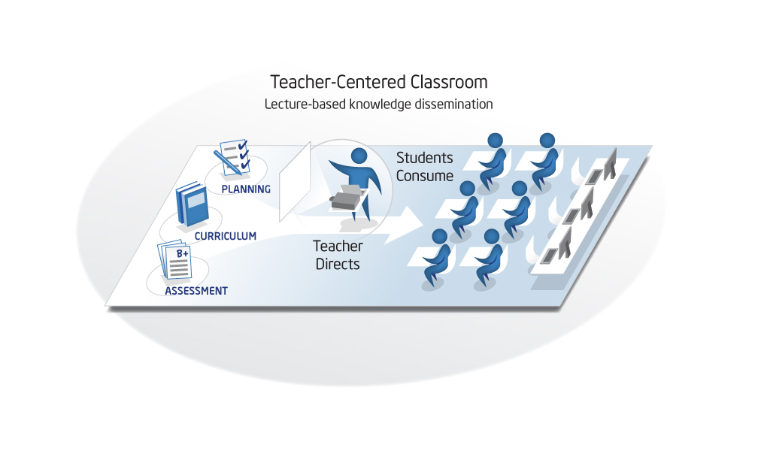
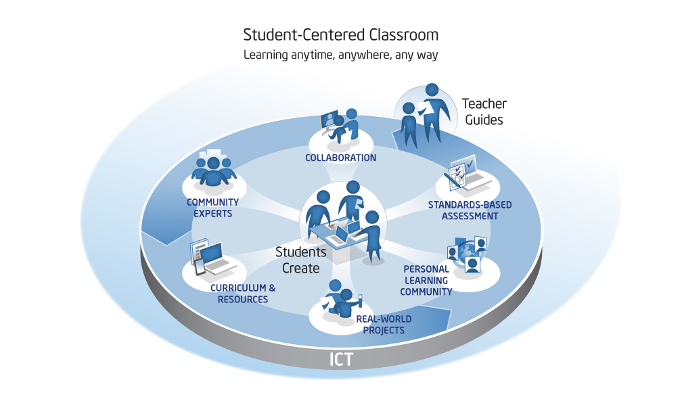
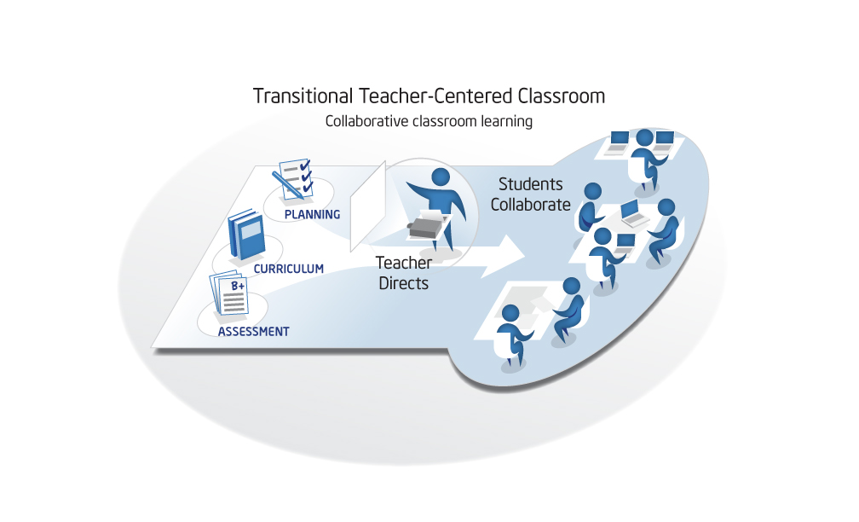
How will a transformed Education look like?

Slide 7
Intel® Teach Programme Portfolio:
All courses enable teachers to support 21st century learning in any subject, using their existing curricula.
Intel® Teach Elements Courses - www.intel.com/teachers
A series of visually compelling eLearning courses for anyone, anywhere, anytime
Project-Based Approaches | Assessment in 21st Century Classrooms | Collaboration in the Digital Classroom | Thinking Critically with Data | Leadership in the 21st Century
K-12 teachers improve their application of PBA to engage students. | K-12 teachers learn to develop student- centered assessment for improved learning. | Helps K-12 teachers prepare students for the globally connect world. | K-12 teachers teach students to think critically about information around them. | Educators explore school leadership in students’ technological world.
Intel® Teach Courses
Substantive, research-proven courses delivered through a “train the trainer” model
Skills for Success | Getting Started | Essentials Course | Essentials Online | Advanced Online | Thinking with Technology | Leadership Forum
ICT Teachers train to use student curriculum that develops digital literacy, problem solving, critical thinking, and collaboration skills. | K-12 teachers are introduced to classroom software productivity tools and student-centered approaches to learning. | In-service and Pre-service teachers develop units that integrate technology into existing classroom curricula to promote student-centered learning. Face-to-face or hybrid face-to-face and online. |  | K-12 teachers build communities to advance their integration of technology and 21st century learning. | K-12 teachers develop project-based units using free online thinking tools to enhance students’ higher-order thinking skills. | Education Leaders focus on supporting and implementing effective technology integration in school.

Slide 8
Percent of teachers meeting each of the four Outcome Indicators (n≈1,922)

Slide 9

Wag the Dog
We measure what we can teach.
We teach what we can measure.
If we cannot measure it, shall we teach it?
http://atc21s.org/
Notes:
To 'wag the dog' means to purposely divert attention from what would otherwise be of greater importance, to something else of lesser significance. By doing so, the lesser-significant event is catapulted into the limelight, drowning proper attention to what was originally the more important issue.
The expression comes from the saying that 'a dog is smarter than its tail', but if the tail were smarter, then the tail would 'wag the dog'.
21st Century Skills are harder to assess than traditional data-retention skills.
Our Research found that:
criteria for assessment are more behavioural
holistic approach is needed
-> Collaboration to be included in PISA 2015
Online Learning / Web 2.0
Innovative teachers use Web 2.0 to create a virtual extension of the classroom [think for example about LAR scenarios, where some schools operate 3 daily shifts!]; in this scenario, the ease of use is key!
Student Response Systems (Clickers) -> exist on mobile phones
The ISO 9000 family of standards relate to quality management systems and are designed to help organizations ensure they meet the needs of customers and other stakeholders. The standards are published by ISO, the International Organization for Standardization. ISO 9000 deals with the fundamentals of quality management systems (Tsim et al, 2002 ^{[2]} ), including the eight management principles on which the family of standards is based. ISO 9001 deals with the requirements that organizations wishing to meet the standard have to fulfill.
A common criticism of ISO 9001 is the amount of money, time and paperwork required for registration.
ISO 9001 is not in any way an indication that products produced using its certified systems are any good. A company can intend to produce a poor quality product and providing it does so consistently and with the proper documentation can put an ISO 9001 stamp on it. According to Seddon, ISO 9001 promotes specification, control, and procedures rather than understanding and improvement. Wade argues that ISO 9000 is effective as a guideline, but that promoting it as a standard "helps to mislead companies into thinking that certification means better quality, ... [undermining] the need for an organization to set its own quality standards." [Paraphrased, Wade's argument is that reliance on the specifications of ISO 9001 does not guarantee a successful quality system.
While internationally recognized, most US consumers are not aware of ISO 9000 and it holds no relevance to them. The added cost to certify and then maintain certification may not be justified if product end users do not require ISO 9000. The cost can actually put a company at a competitive disadvantage when competing against a non ISO 9000 certified company.
The standard is seen as especially prone to failure when a company is interested in certification before quality Certifications are in fact often based on customer contractual requirements rather than a desire to actually improve quality. "If you just want the certificate on the wall, chances are, you will create a paper system that doesn't have much to do with the way you actually run your business," said ISO's Roger Frost. Certification by an independent auditor is often seen as the problem area, and according to Barnes, "has become a vehicle to increase consulting services." In fact, ISO itself advises that ISO 9001 can be implemented without certification, simply for the quality benefits that can be achieved.

Slide 10
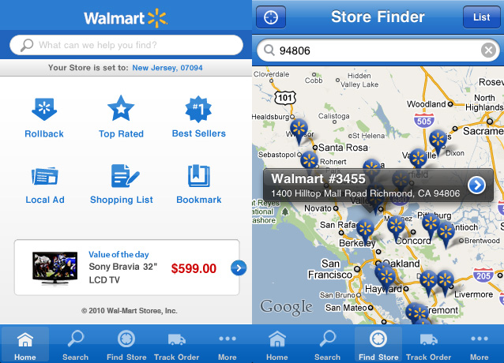
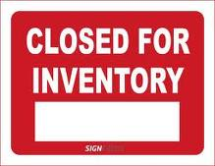
Inventory check in a 2.0 World

Slide 11

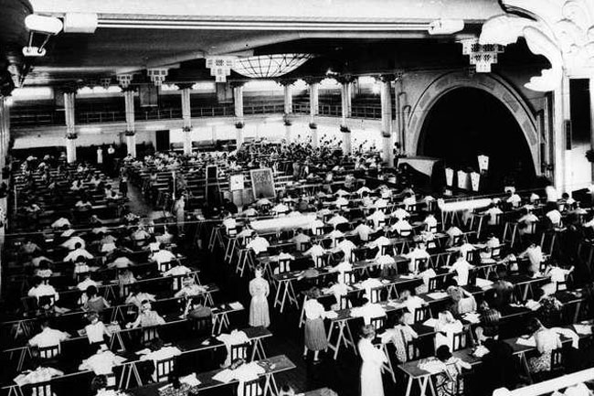
Reality in schools
Notes:
Effective Learning & Teaching
Change comes from
Policy change in: standards, curriculum, assessment
Administration change in: vision of teaching & leadership, support, professional development
Teachers change in practice
Student change in activities

Slide 12
Comfort Zones
Change
Challenge
Comfort
Danger
Notes:
‘Challenge zones’ here is seen as a state of mind. In a learning environment, the aim is to move learners from the Comfort or from the Danger zone into the Challenge zone -> this is where the learning experience is optimised.
The exercise can be used in a variety of settings, e.g. on the playground by defining three zones and letting the pupils skip from one to the other, depending on their reaction to a concept expressed. E.g. if we say ‘Numbers’, most pupils may be expected to skip into the green zone; if we then progress to say ‘Algebra’, some may start moving to the yellow zone, and if we go on to say 2nd degree equation, we are likely to see some skipping into the red zone.
This simple exercise can also be used to assess social or emotional aspects; e.g. if we say ‘lunch time’ and pupils go to the red zone, we may start thinking that they are having issues with food (anorexia?), or possibly are being bullied, or possibly just don’t like the canteen, etc.

Slide 13
Comfort Zones: Practical Example
Food
Challenge
Comfort
Cooking
Your In-Laws
Danger
Cook a 4-course-dinner for 12 guests, including your in-Laws, by 6pm tonight
Notes:
Let’s take a few examples.
The aim of this exercise is to show that everyone can be pushed from the comfort zone, to challenge and to a danger zone.

Slide 14
How will a transformed Education look like?

Slide 16
Personalised Learning
What it is not
What it is
Personalised learning
Inclusive
A variety of media
Differentiated/ levelled resources
Tracking progress
Different styles
Physical activities
Self-paced
Sharing different experiences
Project-based
Making meaning from ideas
e-portfolio
collaborative
(Un)personalised learning
Just diagnostic testing
Traditional teaching
Vocal pupils going off on their own tangents
Passive
Fixed place
Academics in isolation
One-sized fits all instruction
Static text
Notes:
Personalised Learning is the tailoring of pedagogy, curriculum and learning environments to meet the needs and aspirations of individual learners, often with extensive use of technology in the process.

