Slide 1
International cooperation of dutch and slovenian teachers in use of ict
Huub Schoot, Windesheim University of Applied Science

Slide 2

Windesheim University of Applied sciences
Dutch Partners
Four Domains or Academies
Technics
Movement and Education
Health and Welfare
Economics, Management, Media and Communication
Total 21.720 students.
Movement and Education; 7300 students
Succeeding in 3.200 Masters yearly.
.

Slide 3

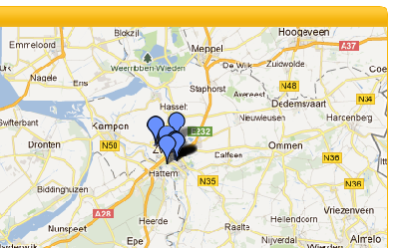
Landstede Group
Dutch Partners
Group of
Fourteen schools for secondary education (12-18)
Vocational training College (16-20)
Courses and in-service training for adults
(18+)
Located in 27 locations in the Zwolle region

Slide 4
The Landstede-Windesheim Science group
Landstede - Windesheim
Pilot group initiated by the school board of the Landstede Group and Harry Frantzen, Head of the Domain Movement and Education of Windesheim.
Aim:
Moodle: A text book free school at Landstede group of schools;
Starting a Knowledge Centre ICT and Education at Windesheim;
Goal: Implementing Moodle in all Landstede schools
Targetpoints
Using Moodle more optimal: Making Moodle example lessons
Meetings with Windesheim advisors, 6 times a year
Discussing and showing usable programs and activities
Visit to Slovenia: Moodle Country

Slide 5
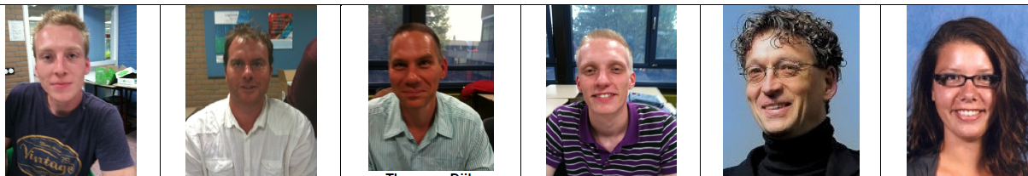
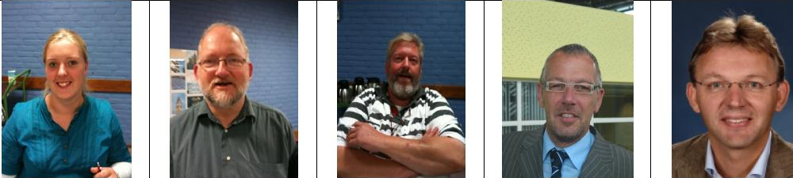
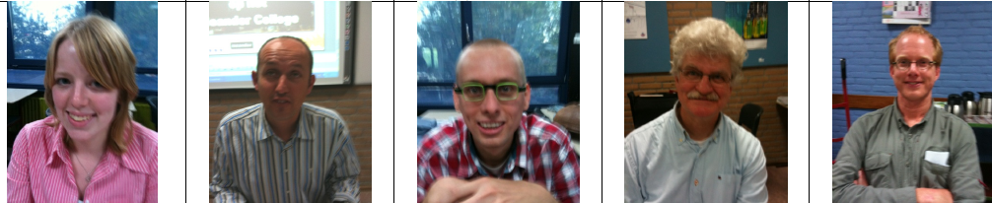
The Landstede – Windesheim Sciences Group
The project
About twelve Science teachers from Landstede Secondary Education schools: Biology, Mathematics, Physics and Chemistry and later English
A school leader from Landstede
Four lecturers from Windesheim: Biology, Physics/Chemistry and Mathematics
Four Student trainees from Windesheim with an internship at the schools

Slide 6
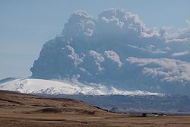
First Visit to Slovenia in 2010:
April: Sirikt Conference
Having a adventurous trip to and from Kransjka Gora
Preparing the excursion to Slovenia with teachers of the Landstede group.
First visit

Slide 7
Visit to Slovenia in October 2010:
Schools and Moodle
= Information on the organization and the use of Moodle in Slovenia;
= Visit to ‘schools of best practice’ in Ljubljana and Bled;
= Meeting with a lot of science colleagues;
= Visits to science classes at different schools and places;
= Different functionalities of Moodle and e-competences;
= Reflecting on the use in Landstede Schools in Bled;
= Making plans for implementation in the Netherlands.
The visit to Slovenia

Slide 8
Counter visit of a delegation of teachers from Slovenia
Counter Visit 2011
Meetings at Windesheim University
Visits to different Schools of the Landstede Group with ICT classes (laptops)
Visits to Zwolle & Surroundings
Starting the teacher-teacher projects with science assessments and ICT

Slide 9
Biology; Jelle van den Bosch & Andrea Premik Banic (Huub Schoot advisor)
Math; Amanda van den Bergh, N. Bajramovic, S. van Beek, S. Stular Mastnak, A Sambolic Beganovic. (W v d Vegt student supervisor)
English; S Grum, Goran Stojanovic
Chemistry; Alex Hak & Marja Pahor
Goal: a common project using ICT with partner classes in Slovenia and the Netherlands
  Biology, Science, Math, English, Chemistry
The results
The teacher projects as a result from the counter visit

Slide 10
Bob’s model
Criteria / Assessment | How will you judge upon your students during or after the project? What criteria will you use.. knowledge, skills, insight, attitude, will,
Transferability | In what way can your project be reproduced / repeated by others?
Final result(s) | Please describe what will be achieved after your ended. This might be on product and/or process level
Evaluation points are in the presentations of ech project and after the last presentation there will be time for questions.

Slide 11









Thank You

