Slide 1
Acids and bases differently
Marja Pahor, OŠ Škofja Loka Mesto, Slovenia
Alex Hak, VMBO Harderwijk location Focus, Netherlands

Slide 2



Why this collaborative project?
Acids & Bases Differently
There are many educational ICT resources we can use in chemistry but we wanted to make a change…
Why not letting students of different countries, different levels and/or different age groups teach each other with the help of ICT?

Slide 3

Age groups/ levels/language:
Acids & Bases Differently
In Slovenia the students were 13-14 years old, the ninth grade of basic education.
In The Netherlands the students were 15-16 years old, grade 4 of the secondary “VMBO-TL” level.
All students had to learn/speak/listen in ENGLISH for the instruction!

Slide 4
Acids & Bases Differently
Learning objectives, curriculum check, expected outcomes
We determined the learning goals and learning outcomes of the topic (cross-section of both countries).
Big difference in level: in SI learn more things in
chemistry at a younger age - Acids and Bases was the best match.
We decided to collaboration (lesson) via „one to one“ Skype video connections with screen shearing (January 27, 2012: 21 SI and 25 Nl students)

Slide 5
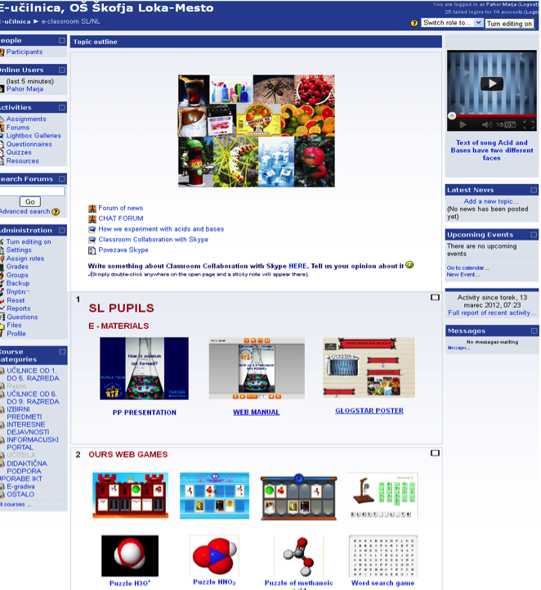
What was needed:
Acids & Bases Differently
an e-classroom (VLE Moodle) was created:
http://www.o-sl-mesto.kr.edus.si/moodle/course/view.php?id=106
enough computers and web cameras;
headsets;
internet connection;
Skype.

Slide 6
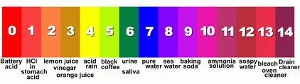
Acids & Bases Differently
Two different didactical approaches to the lesson:
NL approach:
NL students tried to explain
their own presentation
about “the pH-scale”.

Slide 7
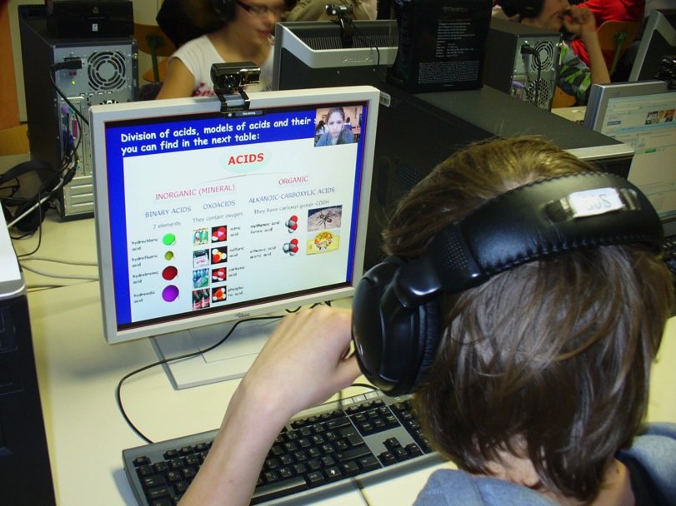
Acids & Bases Differently
SI APPROACH:
Teacher has prepared PowerPoint presentation about How is oxonium ion form. Slovenian pupils explained this learning contents to Netherlands’ students with shearing screen.
They have had a training with Chemistry and English Teacher before.
Foto: A. Bačnik

Slide 8
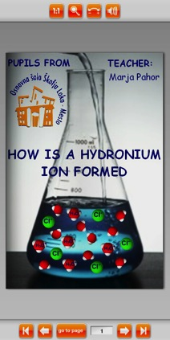
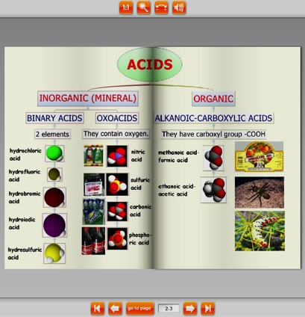
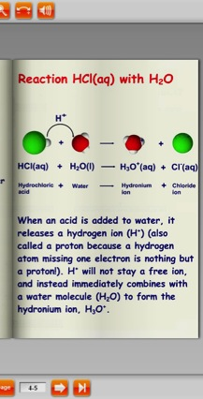
Acids & Bases Differently
SL pupils have prepared Web manual with the teacher's help.

Slide 9
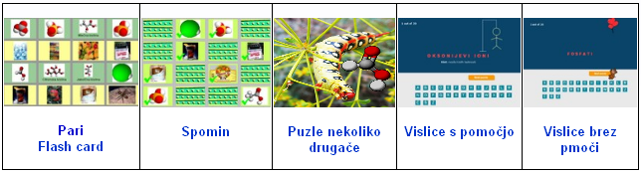
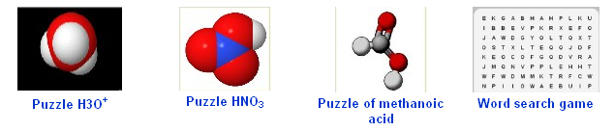
Acids & Bases Differently
Sl pupils have prepared the e-poster in Prezi and different games about acids and bases.
Notes:
…prezi poster and different games about acids and ases with using free web programs. Here is some example.

Slide 10
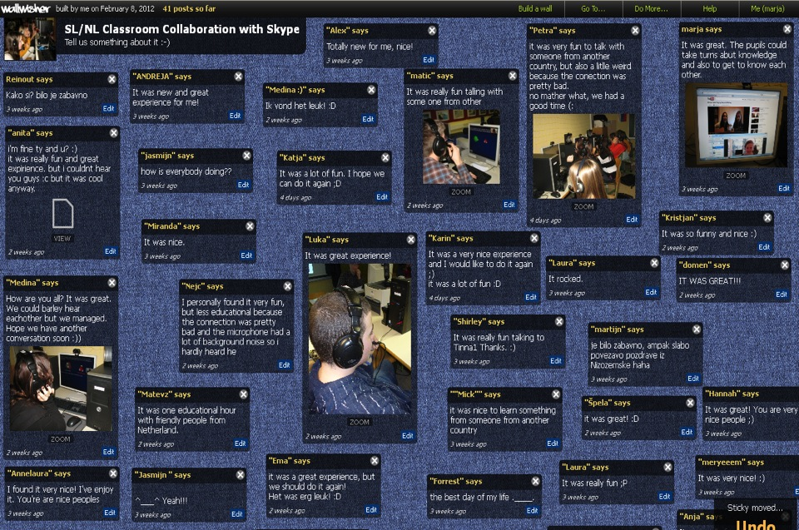
Acids & Bases Differently
THE EVALUATION AND RESULTS:
  Carrying out interviews among the students.
  Letting he students post a “wall wisher”
  (http://www.wallwisher.com/wall/slnlskype)
Notes:
The Wall wisher where the students write their opinions about cooperation. If you read our messages, you can see, that this is great experience for all of us. Quite a few students wrote, they hoped to have another Skype conversation.

Slide 11
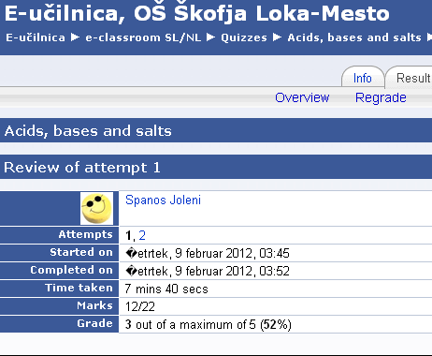
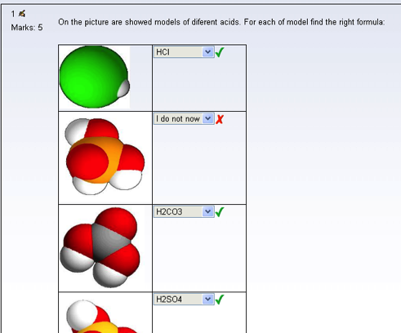
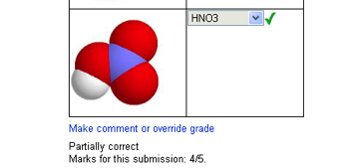
Acids & Bases Differently
accomplishig a „knowledge test“ prepared in e-classroom for NL students by SI students.
Notes:
I opened virtual classroom in Moodle environment for collaboration. I give my students all permission. So they can put their materials in e-classroom. Students have prepared the questions in Word document for Dutch students and then have made the quiz in Moodle environment.

Slide 12
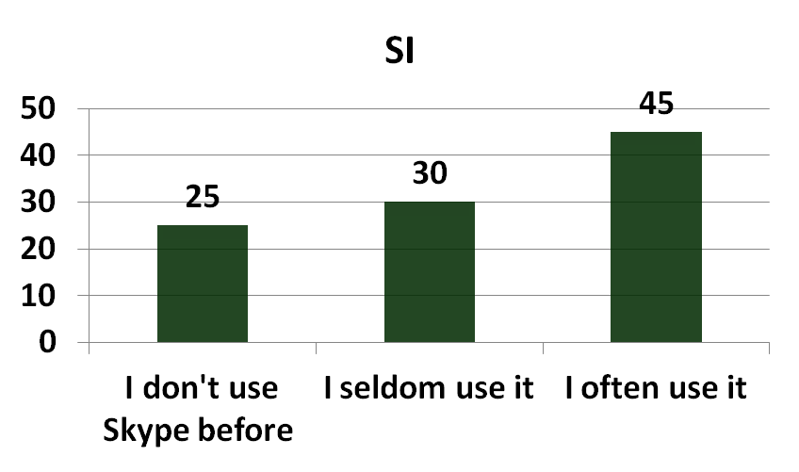
Acids & Bases Differently
  Answering a questionnaire in e-classroom for the pupils.
Results Questionnaire of the Slovenian pupils:
  More than 50 % never used or hardly used Skype before.
What are your previous experiences with Skype?
  76 % got the connection at once, another 12% after connecting to another student.
  42 % did not have any problems with picture and sound.
Notes:
For the evaluateing our work in this study cay of collaboration we have used different tools:
The Questionnaire in e-clasroom for interviews of the students.

Slide 13
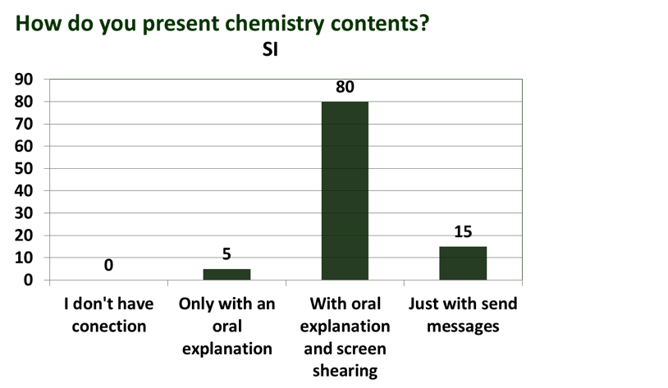
Acids & Bases Differently
  80 % had no problem talking and showing the presentation at the same time.
  The students got good/very good response during explaining in more than 50% of the cases, only 12% did not get feedback.
  Only 41% of the students got an explanation back from the Dutch students about the pH scale.
  85% of the above 41% did understand it, though.

Slide 14
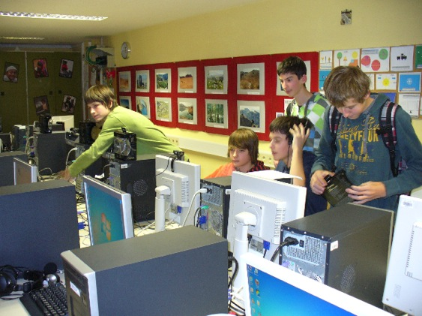
Acids & Bases Differently
  41% established another contact with the Dutch student(s) after this meeting.
  When the SI students have to rate how they liked to work with students abroad they rated 4.9 out of 5.
Foto: A.Bačnik
Notes:
For the evaluateing our work in this study cay of collaboration we have used different tools:
The Questionnaire in e-clasroom for interviews of the students.

Slide 15
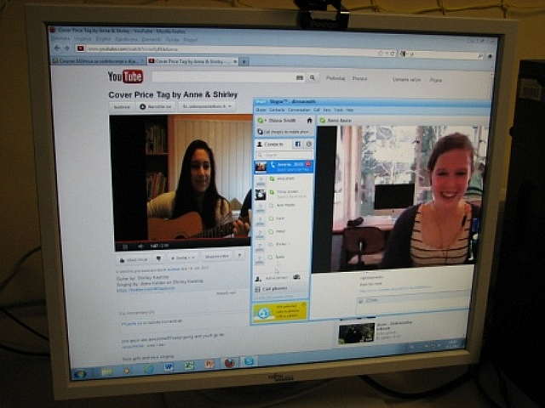
Acids & Bases Differently
THE ADVANTAGES OF THE PROJECT:
All students worked with great spirit and enthusiasm,
they were very motivated for work.
Students upgraded their knowledge of chemistry,
English and digital (ICT) skills (new Web tools, use of Skype for learning with classmates now etc.)
  Some of students kept on communicating, far in break-time; some of them kept in touch after the meeting.
Collaboration of teachers in the and between schools (lots of fun for the teachers; Teachers learn from this too)
Students have the time to known something about themself too.
Foto: H.Markuta

Slide 16
Things that went really well
Acids & Bases Differently
Skype/connection went really well, considering 21 video connections via internet at the same time.
Students were able to switch role from student to teacher.
Students were able to see how things work out in another country.
Students learn better by explaining curriculum to other students.

Slide 17
Acids & Bases Differently
THE DISADVANTIGES OF PROJECT:
Timing for participation, because of different school schedule…
ICT equipment, which is not always appropriate (getting enough web cameras and right headsets for speech and listening).
  It was sometimes a bit noisy because of 21/25 students talking at the same time - Arranging a larger classroom/ more spread out area.
Notes:
And what is the advantages of that case study?
Sledi naštevanje zgoraj navedenih prednosti.

Slide 18
Acids & Bases Differently
THE DISADVANTIGES OF PROJECT (NL):
A difficulty to overcome were some (NL) students who were not very good at English;
  Some of them were too afraid to talk.
  Some of them understood too little of it.
The English language might also be the cause of the not too high scores in the test - average grade was around 2-3 out of 5.
We started with the SI students explaining to the NL students; there was not always enough time left for all the Dutch students to do it the other way around
The quality and equality of the explanation of NL students was different since they had to make their own presentations.

Slide 19
Suggestion:
Acids & Bases Differently
Let the students get to know each other through a Skype meeting so they don’t have to get acquainted first before they can start to teach (Some students were so “thrilled” about this that they forgot to teach….)
Organize more time to let the students communicate .

Slide 20
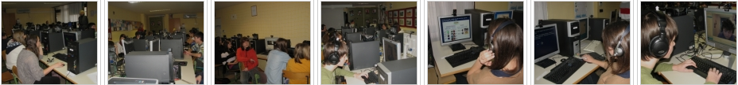
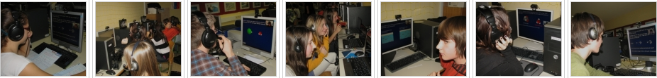
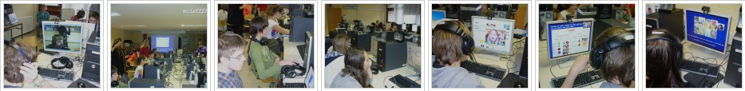
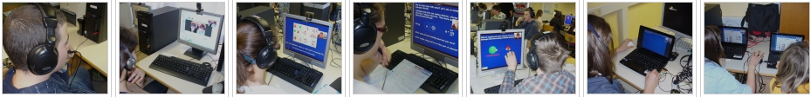
Acids & Bases Differently
Thank you for your attention.
Foto: H.Markuta , A. Bačnik
Notes:
And of course, thank you for your attention.

