Slide 1
RATIONAL FUNCTION - FROM DUTCH STUDENTS TO SLOVENIAN CLASSROOM
Selma Štular Mastnak, Gimnazija Jožeta Plečnika Ljubljana, selma.stular@guest.arnes.si
Willem van der Vegt, Windesheim University Zwolle,
W.van.der.vegt@windesheim.nl
Selma van Beek, Windesheim University Zwolle, selma.van.beek@windesheim.nl

Slide 2
Steps taken
First draft of the lesson material send to Slovenia in November
Waiting for feedback and collaboration in December
First test with Slovenian students in January
First results (presentations) in January

Slide 3
Lesson material (LM) rational functions
Discover the graph of the functions (using Java Applets)
Use Geogebra
Use a dedicated website
Make a presentation of your findings for classmates
Upload answers of LM, translated in English to Moodle

Slide 4
Lesson with Slovenian students
Some starting problems (different learning approach) – needs of additional teacher’s explanation
Coorperation worked rather well
All couples worked most of the time
All presentations & answers received

Slide 5
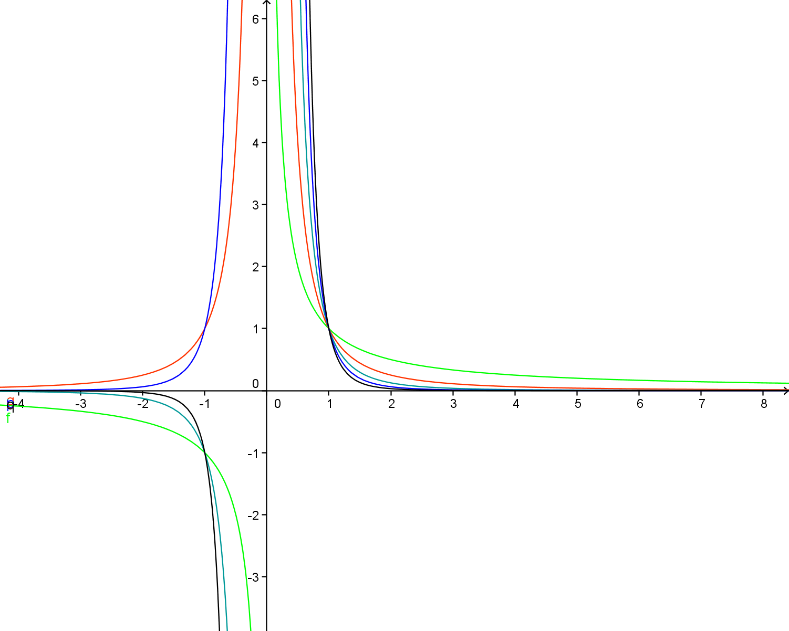
Students work
1/x
1/x²
1/x³
1/x⁴
1/x⁵

Slide 6
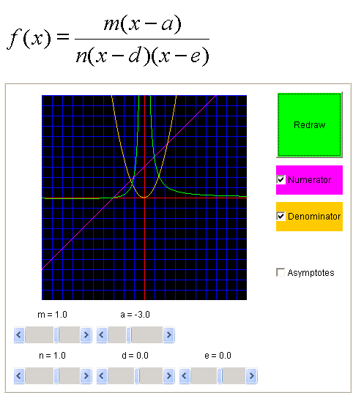
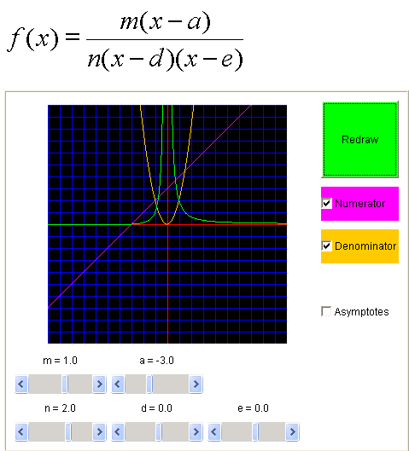
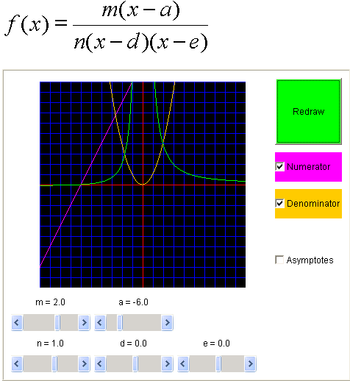
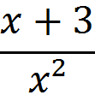
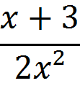
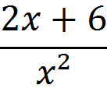
Students work

