Slide 1
Cooperation on distance of eating habits and nutrition
Huub Schoot, Jelle van den Bos, Andrea Premik Banic; Windesheim University Zwolle, Agnieten College Wezep, Jože Plečnik Gymnasium Ljubljana

Slide 2
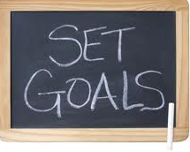
The project for Biology; Goals
Biology project
To teach the same content on two different levels, using different levels of assesment;
The use of ICT, ie Moodle and a nutrient /calories calculating program like Perfect Diet Tracker or paper table;
Evaluating the project with a discussion on the outcomes with Skype;
The pupils of Jelle would cook a healthy Slovenian meal.

Slide 3

Food and nutrition
Assignment 1 What do you eat on next Saturday?
The biology project
        What to do:
Take notes about everything you eat or drink on a Saturday from the moment you wake up till you go to bed;
You should always write down what and how much you eat or drink in pieces or weight. For example you can count the number of bread slices you eat;
Other things such as potatoes or vegetables you can weigh before you eat them;
When you drink something, you note the number of glasses you drank;
Keep in mind that (later on) you have to determine what nutrients and how much of these nutrients are in these products.

Slide 4
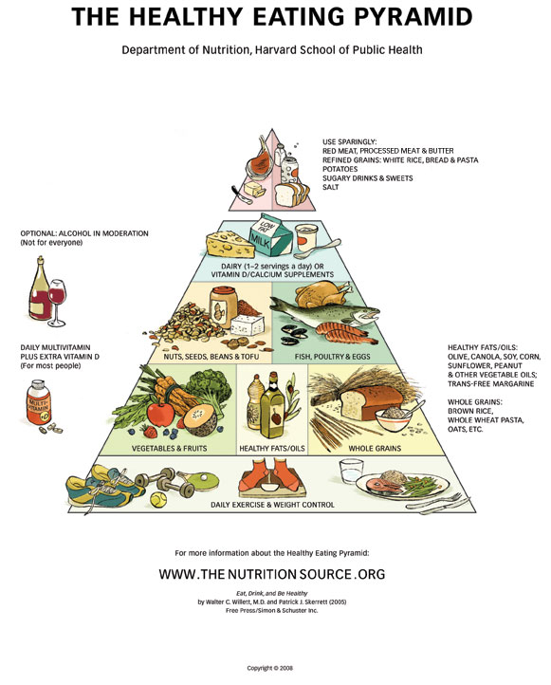
Results
Use the attached table to take notes about everything you eat or create a table on your PC.
You have to continue to include the foods you eat. So always write down the number or the weight of the food items
The biology project
Report
You made a digital table with everything you've eaten on Saturday. Is it correct? Do you eat the same every Saturday?
A discussion on the Healthy eating pyramid (http://www.hsph.harvard.edu/nutritionsource/what-should-you-eat/pyramid/)

Slide 5
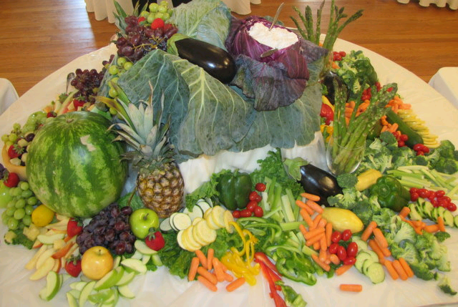
Assignment 2
What nutrients are in the food you have eaten last Saturday?
How much of each?
The biology project
What to do?
Analyze how much of each type of nutrients you've eaten on Saturday.
Calculate this with the help of a table of nutrients on a computer or on paper.

Slide 6
Results
Biology project
Make a report by filling in the table of nutrients you have eaten:
In the top row are all kinds of food that you eat in number and/or weight.
In the left columns, write down the nutrients that can be present in your food
Look in a food table what nutrients are in the foods you eat and calculate exactly how much.
http://www.brianmac.co.uk/foodtables.htm

Slide 7
Table of food/nutrients in the Saturday menu
Biology Project
Example: Please specify your own food and nutrients!
 | Potatoes | Spinach | Meat (kind of) | Sandwiches | Sandwich dressing | Butter
Number:
Weight:
Carbohydrates
Protein
Fat
Vitamines (total)
Minerals (total)

Slide 8
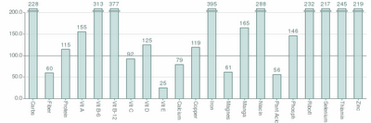
Assignment 3
A personal nutrient table for your meals on Saturday
Biology Project
What to do?
Calculate the amounts of nutrients and write the results on your form.
Results
Make a bar graph of the nutrients in your meals. (in Excel or special program)

Slide 9
Assignment 4
A classroom average nutrient table for Saturday
Biology Project
What to do?
When all students have completed their form and bar graph this form may be copied;
Make sure you get a copy of all the nutrients tables. Calculate the average of your class.
Create a table and a bar graph of the averages of the class.
Results and conclusions:
Compare your own bar chart with the class average table and discuss conclusions:
Difference in age and body weight
Difference in lifestyle and eating habits
Difference in boys and girls
Difference in activities (sport, outdoor activities)
Draw your final conclusions and discuss them with other students .

Slide 10
Assignment 5 A
Classroom average nutrient table for Saturday in the Netherlands and in Slovenia.
Biology Project
What to do?
Compare the averages of your class with the averages of the Slovenian/Dutch students. Draw your conclusions. Discuss them with a student in the partner-country.
Results and conclusions, points to discuss:
Compare the class averages table and discuss conclusions with a partner-student
Differences in age and body weight;
Differences in lifestyle and eating habits;
Differences in boys and girls;
Differences in activities (sport, outdoor activities);
Cultural differences between the Netherlands and Slovenia.
Draw your own conclusions and write these down in your report.

Slide 11
Evaluation
Project biology
Mayor issues:
The project had been successful in developing the materials needed;
Less differences in age, educational level and foreknowledge should have worked better;
Timing of the partner-lessons at the same moment is an issue, caused by school terms and curriculum.

Slide 12









Biologie project
Thank you

