Slide 1





Transforming Learning for future prosperity
Name
Title
Greg Butler
Senior Director, Education Leaders Strategy
Microsoft Corporation
Email: gbutler@microsoft.com

Slide 2





  PROSPERITY COMES FROM OPPORTUNITY
  OPPORTUNITY GROWS FROM INNOVATION
  INNOVATION REQUIRES EDUCATION CHANGE
Notes:
At Microsoft we are inspired by the passion that people around the world have using their hard work and creativity to build strong communities that offer great opportunities and the hope of even better lives for their children. If you think about this boy, his parents send him to school hoping for better opportunities than they had, for him to be able to be whatever he dreams he wants to be. We know
Fundamentally, nations want strong communities that are built on economic opportunity.
In our connected, information-driven world, this kind of economic vitality is fueled by innovation.
We Know the next generation of innovation requires an education that is different from today. An education that excites and inspires the next generation to build the solutions of tomorrow.

Slide 3


Collaborative Problem solving
What might these three countries have in common?
Tunisia
Portugal
Indonesia

Slide 4

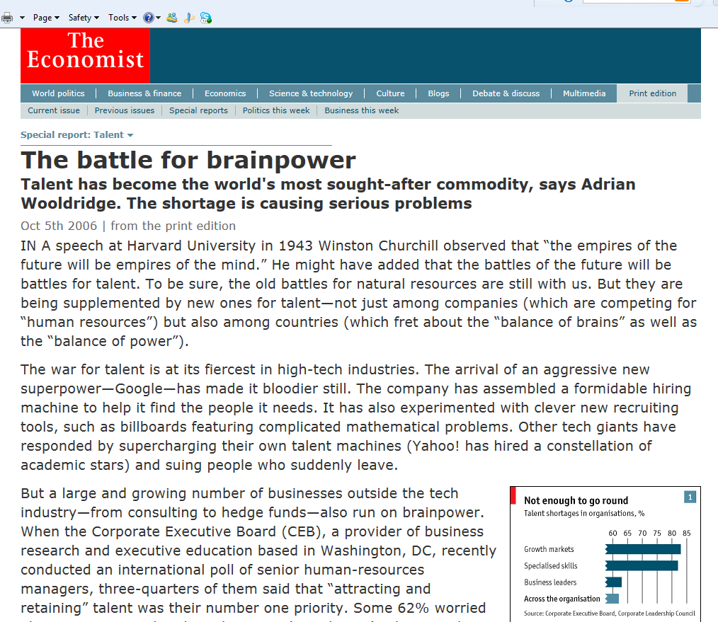

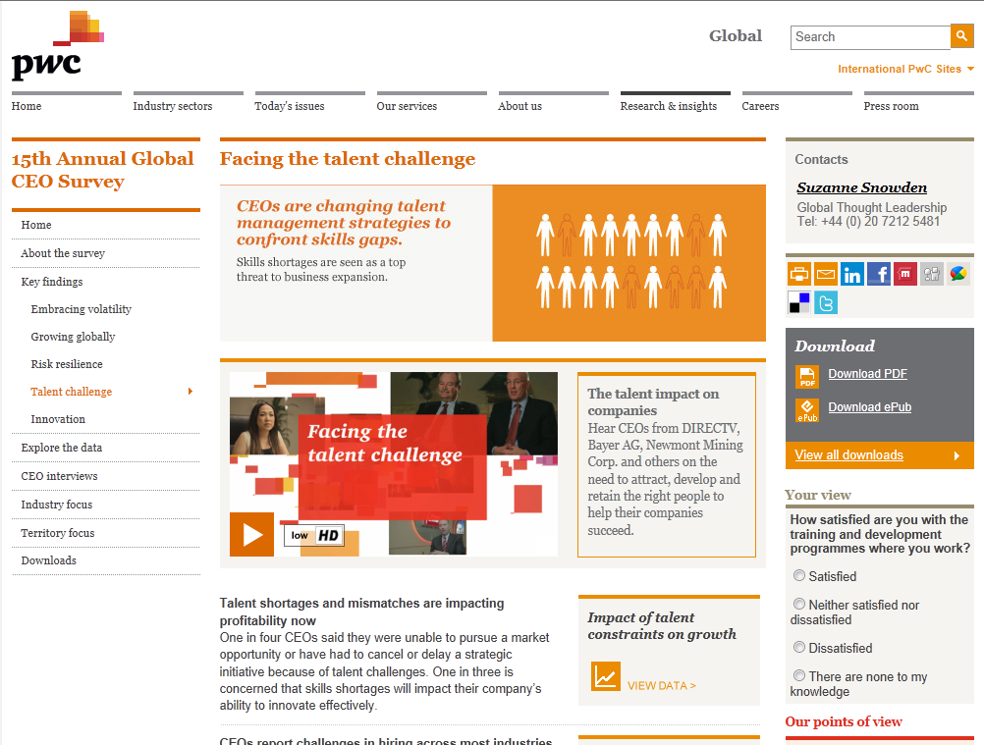

Slide 5
How the demand for skills has changed
Economy-wide measures of routine and non-routine task input (US)
Mean task input as percentiles of the 1960 task distribution
The dilemma of schools:
The skills that are easiest to teach and test are also the ones that are easiest to digitise, automate and outsource
(Levy and Murnane)

Slide 6
The challenge:
A Focused Strategy to Transform Learning
That Prepares Students for Success with Life and Work!

Slide 7




STRATEGIC PARTNERSHIPS
“Public-private partnerships make it possible to multiply the impact that a single organization or company could hope to achieve working alone. “
– Bill Gates
“…The company has invested at an unprecedented scale in building up its capability for partnering over the past decade”
MICROSOFT’S PARTNERSHIP CENTRIC CULTURE - Lessons from a decade of using cross-sector partnerships to promote universal access to digital learning, Rafal Serafin - June 2010
ICT COMPETENCY FRAMEWORK FOR TEACHERS
Notes:
We understand we cannot do this alone and it requires multi-stakeholder partnerships for us to sustain and scale education transformation efforts. We are investing in building the capability of all our employees who work directly with governments in education to be able to manage successful partnership relationships. We believe strategic alliances and partnerships are required for us to solve the greatest challenges facing us in education today.
To be able to help governments be nationally competitive and have a next generation that can fill the jobs that are not yet defined we have tried to answer the challenges posed by governments through three of these partnerships that will effect students, teachers and government leaders.
As we think about education transformation it requires a holistic approach what are the skills, teaching interventions and assessments needed to help students be successful in an information rich knowledge economy, what type of learning environments and innovative teaching practices are needed to help them get there, and lastly what international recognized standards based competencies and certifications can help teachers with their professional development so they can successfully teach their students these skills.

Slide 8


  DEFINING THE SKILLS FOR SUCCESS IN WORK AND IN LIFE
  DEVELOPING TOOLS TO EVALUATE PROGRESS
Notes:
Assessment methods that measure skill development—rather than rote learning—will guide schools toward more effective learning environments that prepare children for the workforce of tomorrow. Transforming education for the 21st century is a global issue that requires a worldwide partnership among governments, educators, academics and industry to make a real and sustainable difference. To make changes in the teaching and learning process at the classroom level, education policy-makers need real-time information about the skills of their student population. There is recognition from decision-makers who set standards and policy, that gathering data through assessment is a critical component to help guide what is taught in schools and to transform education.
In January 2009, Cisco, Intel and Microsoft announced a three year project, the Assessment and Teaching of 21st Century Skills” (ATC21S):a joint effort to sponsor a collaborative research project to support the acceleration of education reform. Each of the three companies has a long history of supporting education initiatives and believes that, as employers of tomorrow’s talent, they share a common interest in applying their collective resources to improve learning and education.
ATC21S started by defining 21st-century skills, future-ready skills, internationally as four broad categories:
Ways of thinking: Creativity, critical thinking, problem-solving, decision-making, learning and innovation
Ways of working: Communication and collaboration
Tools for working: Information and communications technology (ICT) and information literacy
Living in the world: Citizenship, life and career, and personal and social responsibility

Slide 9

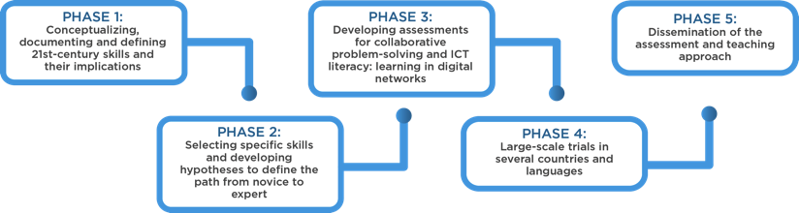
RESEARCH PLAN AND PROGRAM INNOVATION
COMPLETE
COMPLETE
END 2012
NEW FORMATIVE ASSESSMENTS | TIMELY ANSWERS | GLOBAL REACH
IN PROGRESS
COMPLETE
Notes:
ATC21S is the first research effort to:
Define learning progressions for 21st-century skills.
Create common assessment standards and practices.
Form an international assessment effort.
Original efforts: ATC21S is the first international effort to broker common standards and practices in assessing and defining 21st-century skills effectively. ATC21S will provide new formative assessments that define learning progressions for 21st-century skills. It will create timely and common assessment standards and practices.
Robust:
New assessments to define and measure skills in the classroom.
Quick answers with the use of methodology and technology to find out where students’ understanding and use of the skills.
Over 250 specialists, from government, university and industry, are contributing to ATC21S efforts to define the current state of education and create an international standard.
The process: A thoughtful five-phase approach, beginning with conceptualizing the skills, developing assessments around those skills, trying them out in small labs to wide-scale classroom testing and sharing the results in the public domain, for anyone to use.

Slide 10

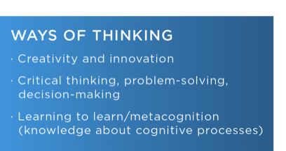


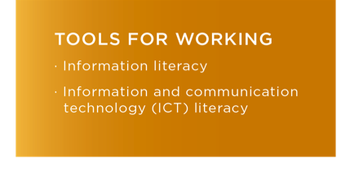

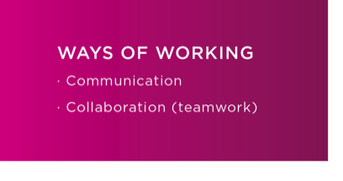

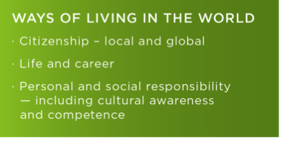
21ST-CENTURY SKILLS DEFINED
ATC21S started by internationally defining 21st-century skills as four broad categories.
Notes:
ATC21S started by defining 21st-century skills, future-ready skills, internationally as four broad categories:
Ways of thinking: Creativity, critical thinking, problem-solving, decision-making, learning and innovation
Ways of working: Communication and collaboration
Tools for working: Information and communications technology (ICT) and information literacy
Living in the world: Citizenship, life and career, and personal and social responsibility

Slide 11

Demo
ACT21S – Collaborative Problem Solving Sample Assessment Tasks

Slide 12


LEARN MORE ABOUT ATC21S
Join the conversation
Attend events
Explore our webpage http://www.atc21s.org
Share lesson plans and learning interventions
Notes:
Images associated with actions:
Researchers — participate in crowd sourcing
Attend events to hear about the work being done: P21
Join ATC21S through LinkedIn
Share: Teachers — post your 21st-century skills lesson plans for other teachers to use and offer input

Slide 13



  MEASURING INNOVATIVE TEACHING
  EXTENDING INNOVATIVE TEACHING PRACTICES
Notes:
Around the world there is a growing recognition that new approaches to teaching and learning are needed. But changing teaching methods can be difficult. The Innovative Teaching and Learning Research project is a multi-stakeholder partnership, sponsored globally by Microsoft Partners in Learning and in each of its 8 countries by local sponsors, most often the Ministry of Education.
ITL Research is focused on finding reliable ways of measuring innovative teaching practices that develop the skills that students will need in the workforce. The goals are to provide evidence to education policy-makers on the most effective ways to support innovative teaching and learning, and to contribute a set of research and professional development methods to schools and education systems.
After its first year of research, ITL has uncovered some important insights about what it takes to be successful in teaching future-ready skills:
Engaging assignments that incorporate both technology, student centered pedagogy, collaboration, and critical thinking are essential
Teachers who collaborate frequently with other teachers are more innovative
Recognition for innovative teaching from school leaders is the most important variable in encouraging school-wide change
And there are findings from ITL at the policy level as well.

Slide 14









ITL RESEARCH
Education System Change
School Leadership and Culture
Innovative Teaching Practices
Individuals with skills for life and work today
Notes:
The Innovative Teaching and Learning Research project (ITL Research) addresses fundamental questions related to this challenge more widespread change in education systems. The project focuses on core questions: Does more innovative teaching help students develop the skills they will need? What are the school and system level conditions that can help innovative teaching and learning expand much more broadly?

Slide 15


WHAT ARE
INNOVATIVE TEACHING PRACTICES?
Student Centered Pedagogies
Extending Learning
ICT Integration
Personalized
Collaborative
Knowledge building
Self-regulation
Problem Solving
24/7 learning opportunities
Global and cultural understanding
By educators
By students
Basic usage vs.
Higher-level usage (for knowledge building and creativity)
Notes:
The investigation centers on the concept of “innovative teaching practices.” Our research design team at SRI International reviewed existing research on the factors that have been shown to have the strongest relationship with learning outcomes to develop this concept. In the ITL model, “innovative teaching practices” refers to three categories of factors: student centered pedagogies that offer opportunities for students to develop future skills, extending learning beyond the classroom in ways most relevant to globalization and problem-solving in today’s world, and the use of ICT to support learning.
We believe information and communications technology (ICT) can support these teaching methods by 1) engaging students with compelling, high quality digital content that is precisely aligned with curricular learning goals, 2) extending these teaching methods (especially personalized learning) to more students with fewer resources, and 3) providing students with tools, information and applications that can enable them to create knowledge products more easily.

Slide 16















7 COUNTRIES PARTICIPATING IN ITL
45+ COUNTRIES USING METHODS
National Board
of Education, Finland
Russian Academy of Education & The Academy for Teachers Training, Russia
The Schools Network, England
Ministry of National
Education, Indonesia
National Ministry of Education, MEXICO
National Ministry
of Education,
Senegal
Sponsored globally by
New South Wales Department of Education & Training, Australia
Notes:
In 2011, ITL Research teams worked with policy and research partners in each of the seven participating ITL countries.
And we now have schools in over 45 countries using the research methods developed by ITL to measure innovative teaching in their own schools.
ITL is a multi-stakeholder partnership, with Microsoft as the global sponsor and individual countries sponsors in each country. We are always open to more countries and partners joining, especially as we move into the next phase.

Slide 17


L
EARNING
A
CTIVITY
SCORES
Source: ITL 2011, LASW method, based on analysis by SRI International
Notes:
This chart shows the Learning Activity scores across all the innovative schools from all 7 countries in our study on several ‘21c skill’ dimensions. In ITL, we have developed and tested over the past three years, rubrics for each of these skills that allow researchers and teachers to “code” a specific learning activity (assignment or lesson) giving it a 1-4 score according to how deeply the activity asks for students to use a specific skill. 1 is the lowest possible score, and as you can see here, most lessons did not require students to develop these skills very deeply…
In fact, most learning activities scored a 2 or lower on each skill, suggesting most teachers do not have a clear understanding of how to design learning activities that require students to use these skills. Why is this important?
[Research teams and trained teachers coded learning activities and student work on each skill (e.g. collaboration, knowledge buildling…), on a scale from 1 to 4. ]
So, all this suggests that even in fairly innovative schools, students are not being offered very many opportunities to experience innovative teaching and learning. The items on this chart are often called “21st Century skills” that students will need to succeed in today’s world. Why are they not offered these experiences?

Slide 18
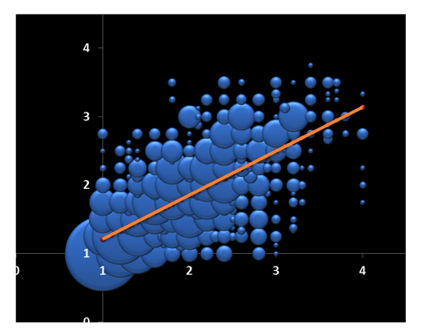
INNOVATIVE TEACHING PRACTICES ARE ASSOCIATED WITH 21ST CENTURY LEARNING OUTCOMES…
BUT GOOD EXAMPLES ARE RARE
Students 21C Skills Score
Learning Activity Score
(Innovative Teaching)
Source: ITL 2011, LASW method, based on analysis by SRI International
Notes:
Because student’s work (and skills) are mediated by the design of the learning activity. This 3D chart shows Learning Activities scores in relation to Student work scores by the frequency of scores at each level. The data shows the strong, positive correlation between the degree to which learning activities called for 21st century skills, and the level of the corresponding skills displayed in students’ work. Low scores on learning activities mean low scores on these skills in the student work. The design of the Learning Activity is the most essential element because over 85% of the variation in student scores was explained by the learning activity score.
So, even in fairly innovative schools, students are not being offered very many opportunities to experience innovative teaching and develop future skills.

Slide 19





WHY NOT
Student Centered Pedagogies
Extending Learning
ICT Integration
Notes:
Why are more teachers not adopting innovative teaching practices? That is the key question here. Let’s start with ICT integration.

Slide 20

WHY IS ICT INTEGRATION HARD?
Teachers say …
Percent Teachers Citing Most Significant Barrier
Source: ITL teacher survey, 2011
Based on analysis by SRI International
Notes:
Overall, the most frequently cited barrier to ICT integration is a lack of computers for students to use – 25% of teachers in our sample cited this as the most important barrier.
If we think about preparing students for work in knowledge based economies, 1:1 computing, as we know in our personal work experience, is the key to developing real collaboration, knowledge-based products.

Slide 21

AND STUDENTS USE ICT…
High level uses of ICT
Basic uses of ICT
Source: ITL teacher survey, 2011
Based on analysis by SRI International
Notes:
Furthermore, ITL data shows that when students use ICT for class-related activities, they are most often using it in basic rather than higher-level uses that demand knowledge-building or collaboration. This is important because basic uses of ICT tend continue traditional teaching practices, just incorporating technology. The process of teaching is often not changing.
But remember, ICT is only one aspect of what we mean when we talk about “innovative teaching.”

Slide 22




Fragmented practices
Student Centered Pedagogies
Extending Learning
Innovative Teaching Practices
ICT Integration
Missing pedagogical elements of innovation
Notes:
This issue of the process of teaching not changing was further emphasized when researchers directly observed classroom teaching in action. The other elements of “innovative teaching” in our model are pedagogical. But researchers rarely saw advanced pedagogies combined with technology use in classrooms. In observing actual teaching practices in classrooms, researchers often saw ICT use, and they saw some examples of advanced pedagogies. But they almost always found them practiced separately. The researchers rarely found them integrated together in a coherent lesson that could provide a qualitatively different learning experience. And in fact, there were indications that teachers and school leaders miss the pedagogical elements when they talk about innovation. Researchers said: “Teachers and school leaders tended to ‘co-opt’ innovation, 21st century skills and technology in their school improvement endeavours.” – England Report – This conceptualization misses the heart of innovating teaching, which is the integration of pedagogical elements with technology.

Slide 23


PROFESSIONAL DEVELOPMENT
AND INNOVATIVE TEACHING PRACTICES
Practice a new teaching method
0.28
Conducted individual or collaborative research on a particular topic
0.25
Planned or practiced using ICT in teaching
0.23
Reviewed and discussed student work
0.23
Observed a demonstration of ICT use
0.18
Developed or reviewed curriculum materials
0.18
Received or delivered one-on-one coaching or mentoring
0.17
Planned a lesson or a unit
0.15
Observed a demonstration of a lesson
0.15
Listened to a lecture
0.03
Source: ITL teacher survey, 2011
Based on analysis by SRI International
Notes:
The quantity and type of Professional Development matters a lot to the adoption of innovative teaching practices. This chart shows the difference (from the mean) in innovative teaching practices among teachers who participated in different types of PD. ITL found that teachers who report the most innovative teaching practice engage in particular types of professional development. They research and practice new teaching methods. This is a kind of modeling of active learning.
Note: These findings control for the number of hours of PD. That is, we expect more active PD to also take more time (and we know that raw PD hours predict innovative teaching), so controlling for total hours removes the component of time from this effect.This chart shows the average difference in the innovative teaching practices index for teachers who participated in a particular type of professional development, compared to teachers who did not.
In general, the data suggest that more active professional development activities are more strongly related to innovative teaching practices than less active professional development activities. This finding is consistent with other research (e.g., Garrett, 2001).
a. Listened to a lecture
b. Observed a demonstration of a lesson
c. Observed a demonstration of ICT use
d. Planned a lesson or a unit
e. Practiced a new teaching method
f. Planned or practiced using ICT in teaching (for example, planning a lesson, developing student activities and assignments)
g. Received or delivered one-on-one coaching or mentoring
h. Conducted individual or collaborative research on a particular topic
i. Developed or reviewed curriculum materials
j. Reviewed and discussed student work

Slide 24





SYSTEM DISCONNECTED
FROM INNOVATIVE TEACHING PRACTICES
“Innovative practices remain individual initiatives of motivated teachers. Being an innovative teacher has no direct and explicit impact on one’s career.”
Senegal ITL Report
“My success is judged by examiners, by Ofsted, by parental choice… and what parents want, what children want is not necessarily what I would judge as innovation.”
School leader, England
Student Assessments
School and Teacher
Performance
Professional
Development
Notes:
And finally, just as we found that innovative teaching practices tended to be fragmented, the conditions and systems in which teaching and learning take place tend to send very mixed signals to teachers and schools. Teachers felt they did not have coherent professional development for innovative teaching; in many schools teachers described school cultures that did not nurture innovative teaching through having a consistent and shared visions of innovation, through teacher appraisals that recognized new teaching approaches, nor through simple encouragement for new teaching methods; and finally, almost all participants in the study reported current student assessments as a barrier to the adoption of innovative teaching and learning. Teachers and school leaders from all six countries in the study that practice extensive national student testing reported strong tensions between goals for innovation and accountability based on student scores on traditional tests. Finland is the exception to this practice, with limited national testing for students.

Slide 25





Connect Systems: Assessments and appraisals aligned with innovative teaching and learning goals
Cultivate innovation: Leaders who develop integrated and shared visions of innovation
Nurture adoption: Professional development that provides teachers collaborative opportunities to design and research innovative teaching
Enrich learning: Ubiquitous student ICT access
Notes:
So, to put this all together in one big picture of how conditions at each layer of the education ecosystem can most effectively support adaptation to 21st century pedagogies and skills, the ITL Research findings suggest :
First, continue efforts to provide ubiquitous access to ICT for students, to ensure that all students have equal opportunities inside and outside school to develop the skills they will need for life and work
Second, teachers need a particular kind of professional development, PD that leverages the most innovative teachers to develop peer collaboration focused on teachers themselves designing, practicing and researching more innovative teaching approaches that students’ future skills
Third, we need to cultivate school leadership and cultures that provide more holistic and shared visions of the integration of advanced pedagogies with technology.
And finally, educations system leaders need to provide the assessment and performance appraisal conditions in which more innovative teaching and learning can flourish.

Slide 26



MEASURE INNOVATIVE TEACHING USING
PARTNERS IN LEARNING SCHOOL RESEARCH
www.pilsr.com
Research Tool for Schools
Based on
ITL Research Surveys
Measures Innovative Teaching Practices
No costs
Basis for Common Vision
International
34 languages
Notes:
Partners in Learning School Research (PILSR) provides individual schools with a complimentary tool to measure their own innovative teaching practices that develop the skills students need for life and work today. PILSR supports schools in their efforts to change teaching and learning in practice, provides tangible measures of innovation, and helps establish a common vision for innovative teaching and learning.
Note: items in the wheel are key benefits as well as differentiators for the PILSR program.
The PILSR tool is available online and at no cost to any primary or secondary school around the world. Surveys and reports help educators and school leaders understand, measure, and drive innovative teaching practices -- in their own environment.
The online tool includes:
•Online surveys unique for each school
•Leadership team and teacher surveys
•Easy, automated, and requires minimal time commitment
•Confidential and anonymous responses
•Reports that include
•School-specific measures of innovative teaching
•Practical definitions of 21st century skills
•Example innovative lessons
•Ability to compare results to local, regional, and global benchmarks
•Connected to ITL Research methods/global findings
•Individual school data is not identified (each school’s data and each teacher’s data remains anonymous)
PILSR is proving to be a pretty powerful tool. MSFT is the only company out there offering this kind of research tool. This kind of individual, school-level research tool is a true differentiator for MSFT on the education front and is especially attractive given the power of the results as well as the ease and no cost associated with participation.

Slide 27
27
[School Name]
School Research
Innovative Teaching Practices Index*
The chart on the right shows how educators at [School Name] report their use of the different elements of innovative teaching practices, and how school leaders estimate the use of these practices among educators in the school. These practices are described in more detail on the following pages.
Other related research demonstrates that innovative teaching practices are strongly associated with students’ development of 21st Century skills (see www.itlresearch.com).
Student Centered Pedagogy
Extending Learning
ICT Use
*All items are measured based on educators’ reported frequency of a practice on a 5 point scale. Higher scores indicate a higher reported frequency of a practice. All items show averages across all responses from the school for each group (educators and school leaders). Data has been adjusted to account for the number of times a class meets per week.
**Student and Teacher ICT Use has been calculated taking the average of basic and high level technology use (see pages 10-11).
Notes:
Here is an example page from the PILSR School report – showing example data of how teachers and school leaders report using all the dimensions of innovative teaching practices in that school

Slide 28
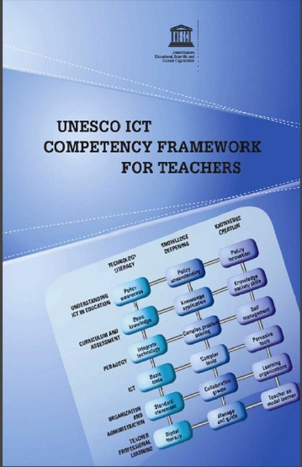
TEACHER SKILLS: UNESCO ICT COMPETENCY FRAMEWORK FOR TEACHERS
Notes:
Over the last 8 years Microsoft has partnered with UNESCO, Intel, Cisco and ISTE to create the UNESCO ICT CFT, a comprehensive framework to develop and deliver teacher professional development for effective integration of ICT.

Slide 29
The CFT Framework
POLICY & VISION
TECHNOLOGY
LITERACY
KNOWLEDGE
DEEPENING
KNOWLEDGE
CREATION
CURRICULUM & ASSESSMENT
BASIC
KNOWLEDGE
KNOWLEDGE
APPLICATION
21ST CENTURY
SKILLS
PEDAGOGY
INTERGRATE
TECHNOLOGY
COMPLEX
PROBLEM SOLVING
SELF
MANAGEMENT
ICT
BASIC
TOOLS
COMPLEX
TOOLS
PERVASIVE
TOOLS
ORGANISATION & ADMINISTRATION
STANDARD
CLASSROOMS
COLLABORATIVE
GROUPS
LEARNING ORGANISATIONS
TEACHER PROFESSIONAL DEVELOPMENT
DIGITAL
LITERACY
MANAGE &
GUIDE
TEACHER AS
MODEL LEARNER

Slide 30

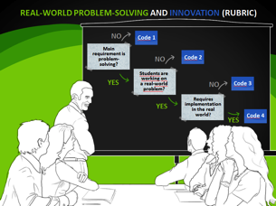
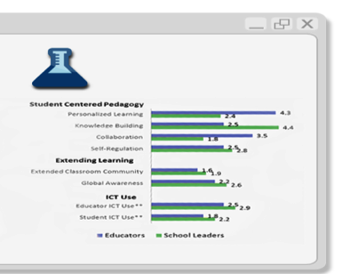
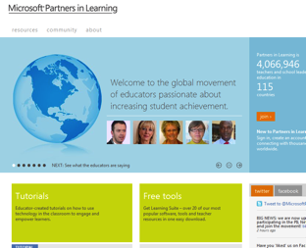
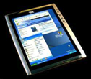
Measure and build innovative teaching capacity
Measure:
PILSR.com
Support:
ITL LEAP21
Partners in Learning
Network
Measure
progress:
PILSR.com
Notes:
PILSR can measure innovative teaching, but schools and teachers need integrated, connected professional develop to build innovative teaching capacity. So Microsoft is sponsoring the development of a new professional develop program based on ITL Research’s Rubrics for 21C skills. This new program is called ITL LEAP21.

Slide 31


TEACHING
CAN CHANGE,
DRAMATICALLY
Case study from one school in Russia
Notes:
In one school in Russia where this training was carried out, learning activities scores on 21C skill dimensions improved dramatically in one year. We are currently developing and testing this program in all of the 7 ITL countries, including Australia. When they see how changes in their teaching can impact their student’s skills for the future, teachers can and do change.

Slide 32
A Partner in Education
Partnerships
Collaborative Learning Platform
Reliable ICT Infrastructure
Education Analytics
Curriculum
Cloud and On-Premises
Business
Software
Research
Assessment
Palette of Learning Tools

Slide 33

© 2009 Microsoft Corporation. All rights reserved. Microsoft, Windows, Windows Vista and other product names are or may be registered trademarks and/or trademarks in the U.S. and/or other countries.
The information herein is for informational purposes only and represents the current view of Microsoft Corporation as of the date of this presentation. Because Microsoft must respond to changing market conditions,
it should not be interpreted to be a commitment on the part of Microsoft, and Microsoft cannot guarantee the accuracy of any information provided after the date of this presentation.
MICROSOFT MAKES NO WARRANTIES, EXPRESS, IMPLIED OR STATUTORY, AS TO THE INFORMATION IN THIS PRESENTATION.

